Slide 1
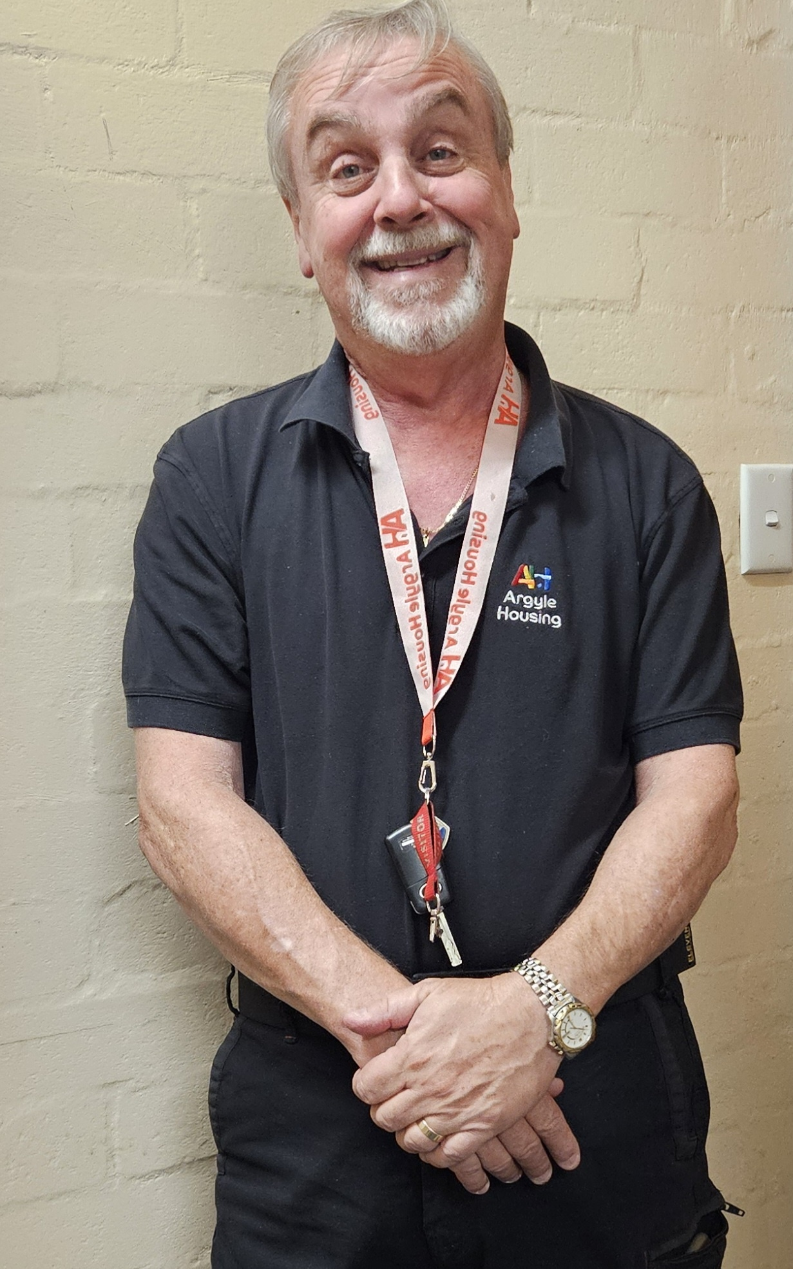
2024 Autumn Edition Common Ground
New Staff Introduction
Reconciliation Day moves to Commonwealth Park
The seventh annual Reconciliation Day event will be held on Monday 27 May in Commonwealth Park. The free family-friendly event will run from 10am to 3pm, featuring Aboriginal and Torres Strait Islander music, entertainment and workshops. Reconciliation Day is a time for all Canberrans to learn and share histories, cultures, and achievements and explore how each of us can contribute to achieving reconciliation in Australia. Play, explore and discover at the event to show your support for reconciliation
My name is Robert, I am the new Maintenance Officer, and I am looking forward to meeting everyone.
Argyle Housing Common Ground 130 The Valley Avenue , Gungahlin ACT 2912
T: 1300 274 953 Direct: 02 6242 3608 E: commonground@argylehousing.com.au

Slide 2
Prevent fires from heaters & open fires
Keep everything one metre away from your heater.
If you suspect a fault, report to our maintenance line or reception.
Never use a wheat bag to warm your bed up, as it may spontaneously ignite.
Know where to go for your weekend sports injury
The emergency department isn’t your only option for sports injuries.
Walk-in Centres can treat simple limb fractures to your lower arm, hand, wrist, fingers, lower leg, ankle, feet and toes, along with soft tissue injuries such as sprains.
Nurses will assess your injury and provide initial treatment along with a care plan.
Gungahlin Walk-in Centre is free and open every day from 7.30am to 10pm.
ACT Walk-in Centres are part of the national network of Medicare Urgent Care Clinics.
Client Portal
We have an amazing online portal for our client to use! You can pay rent, see newsletters, make enquiries, request for maintenance without coming to the office. If you're struggling to use, don't hesitate to ask our CSS!
https://portal.argylehousing.com.au/dashboard
Reminder: Smoke Alarms are required by law to be tested every year. We have arranged for the Smoke Alarms Australia to conduct these tests. Letters have been sent, so please provide access. If you are required to change the appointment. Please contact Smoke Alarms Australia on 1300 125 276

